Slide 1
DW3000 TWR and PDoA Slotted Demos
August 2021
© 2021 Qorvo US, Inc. Qorvo Confidential & Proprietary Information

Slide 2
Setup
This ppt contains two embedded videos.
They illustrate the DW3000 slotted TWR-PDoA demos in action.
The PC DecaRanging Demo runs on the STM32F429 platform or nRF52840.
The SLOTTED PDoA GUI Demo runs on the STM32F429 or nRF52840 platforms.
The evaluations board setup is clearly out lined in the Quick Start Guide.

Slide 3
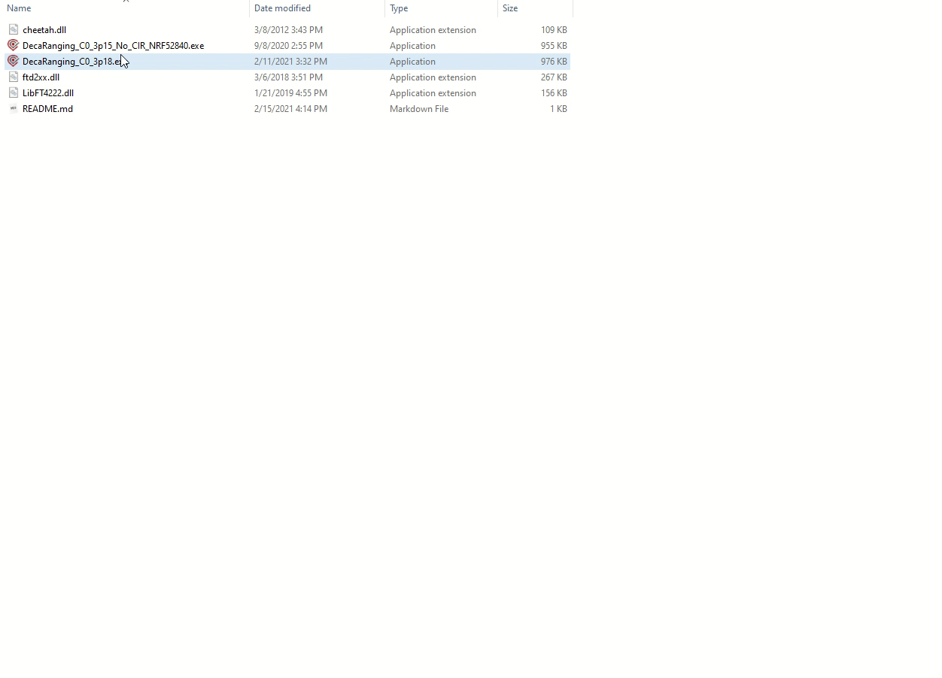
DecaRanging PC DEMO Video
Two DW3000 EVAL connected to two DecaRanging PC applications.
Using one DecaRanging, one DW3000 operates as a Tag, another as a Listener and an Anchor after that.
Both Ipatov and STS preamble Channel Impulse Response can be evaluated.

Slide 4
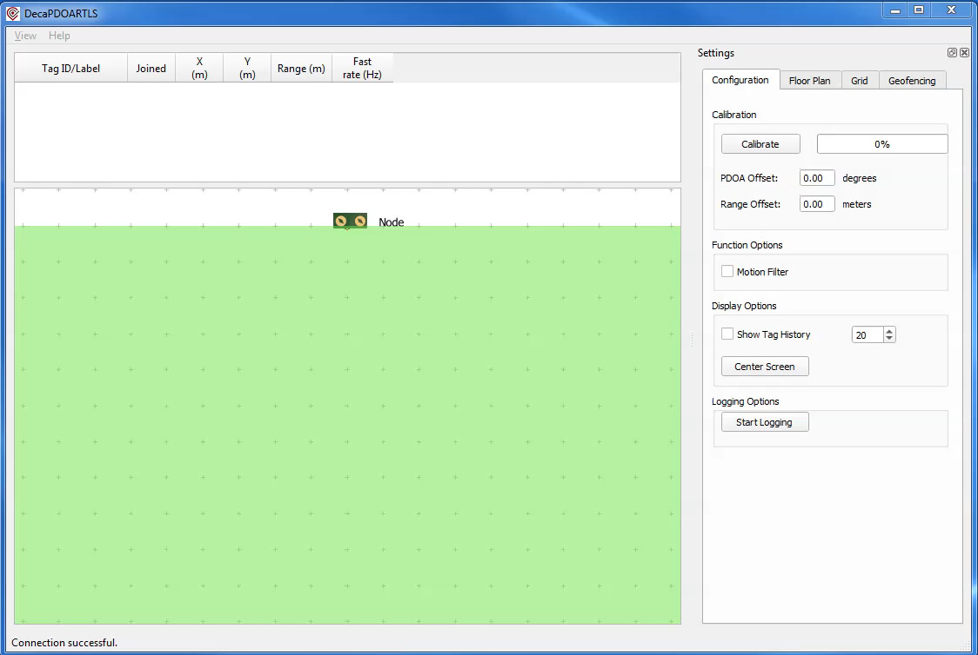

SLOTTED PDoA GUI DEMO Video
The operation of the DecaPDOARTLS.exe is demonstrated on the video
The Dual-port DW3000 EVAL with ML-v1.0 antenna is connected to the PC
The tag app on another EVAL has started and joined the node
Then the tag is moved to the right and to the left in front of the Node

